Slide 1
Leaderboard Competition: NLP with Disaster Tweets Dataset
Project Team: HAAAT
Harish, Aryan, Ashwin, Abrielle, Tahir
December 15, 2023

Slide 2
CS410 Project Team (“HAAAT”)
Tahir Bagasrawala (tahirib2)
Ashwin Saxena (ashwins2)
Aryan Gandhi (aryang6)
Abrielle Agron (aa106) (Captain)
Harish Venkata (hkv2)

Slide 3
Dataset

Slide 4
Dataset: High Level
Where did we get the data set from?
Kaggle’s Natural Language Processing with Disaster Tweets.
What are we predicting?
We’re predicting whether a given tweet is about a real disaster (1) or not (0).

Slide 5
Dataset: Details
What files are we using?
Training set: train.csv
Test set: test.csv
Sample submission file: sample_submission.csv
What columns does the file have?
id - a unique identifier for each tweet
text - the text of the tweet
location - the location the tweet was sent from (may be blank)
keyword - a particular keyword from the tweet (may be blank)
target - in train.csv only, this denotes whether a tweet is about a real disaster (1) or not (0)

Slide 6
Purpose: Beat the Baseline Model

Slide 7
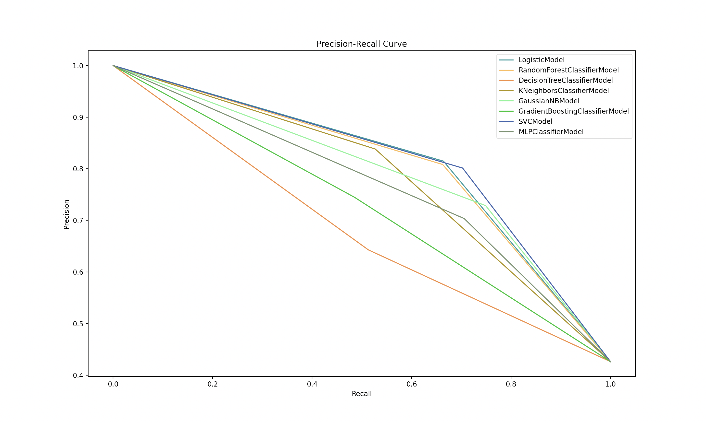
Leaderboard Competition Results
Lower recall: Baseline (Logistic) is the best performer
SVC, Random Forest, and K-neighbors are close contenders
Higher recall: SVC is the best performer
Logistic, Random Forest, and Gaussian Naïve Bayes are close contenders
Competitor must attempt to outperform the Logistic Model on a test set

Slide 8
Setup Process (quick!)

Slide 9
Installation
Download or clone the following repository onto your local machine: https://github.com/tahirbags/cs410_project_public
Ensure you are using a version of python >= 3.6
Inside the repository, create a virtual environment:
python[3.x.x] -m venv myvenv
source myvenv/bin/activate
Inside the virtual environment, run the following:
pip install scikit-learn
pip install pandas
pip install matplotlib

Slide 10
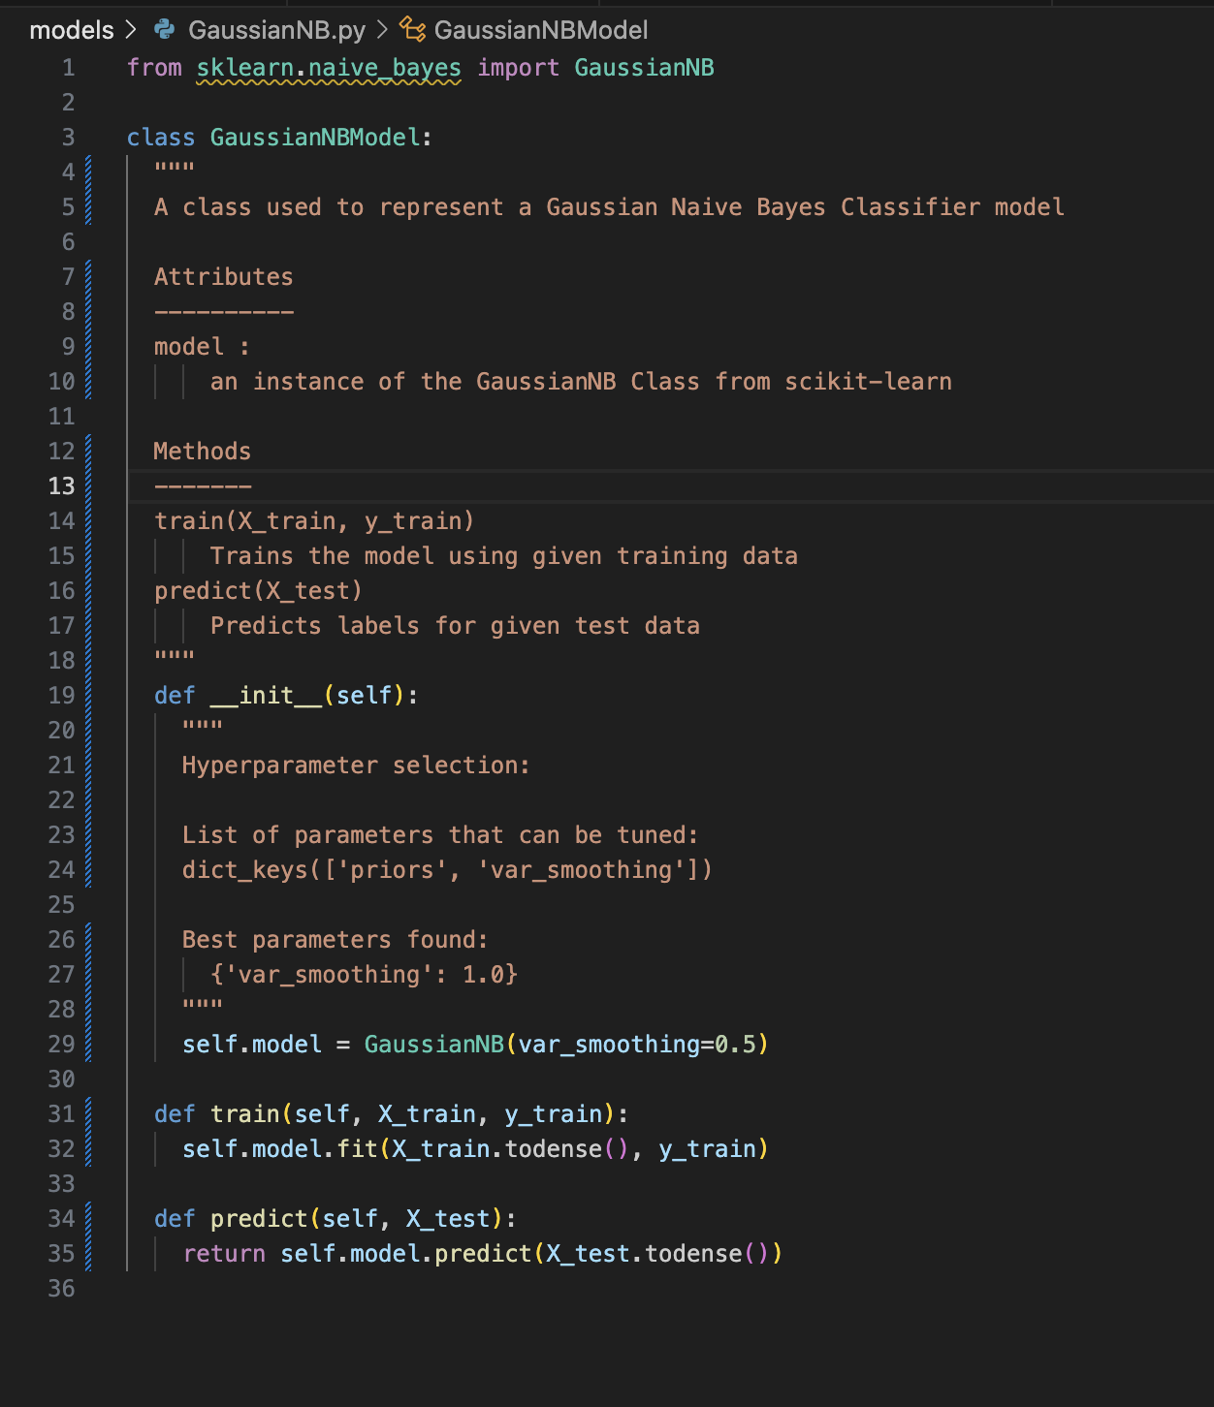
Model Setup (using sklearn)
In the models/ folder, either:
select an existing file (e.g. GaussianNB.py, MLP.py)
create a new file named [yourModel].py
Define the class for your model, with the following three methods:
__init__(self)
train(self, X_train, y_train)
predict(self, X_test)

Slide 11
Usage

Slide 12
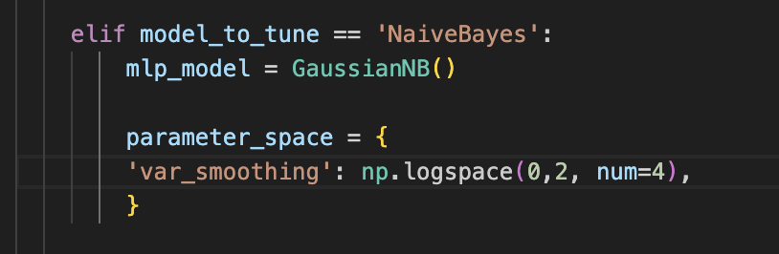
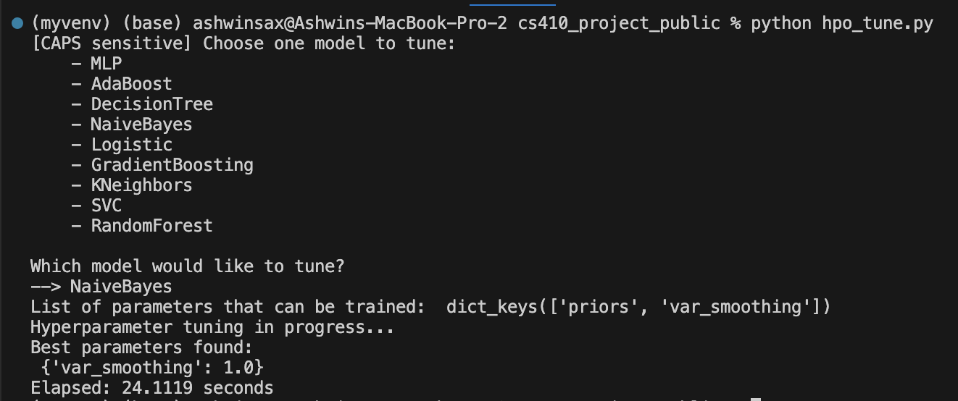
Hyperparameter Tuning on Training Set (hpo_tune.py)
Ensure that your model is listed in the options and if/else branches of hpo_tune.py.
In the respective branch, update the parameter space for your model.
Call hpo_tune.py and enter your model name.
Your model’s hyperparameters will be tuned based on the parameter space you have defined, and the best settings will be printed to the console
Update your model with these new settings

Slide 13
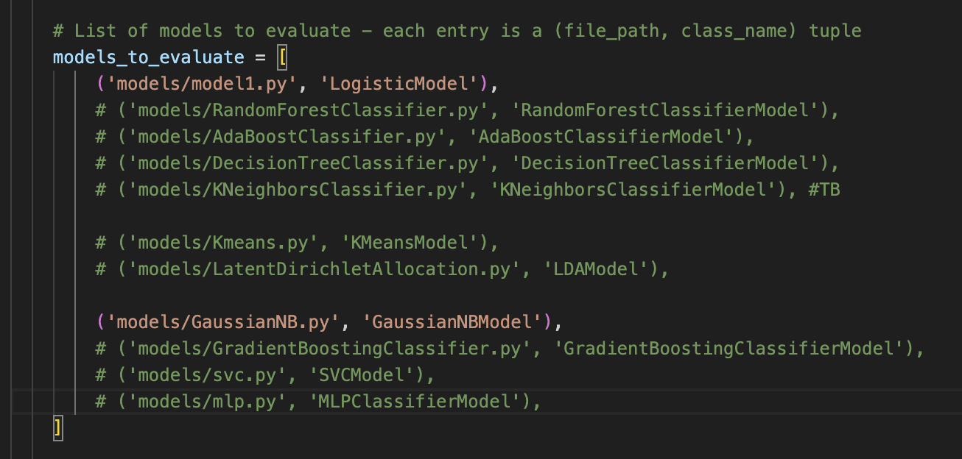
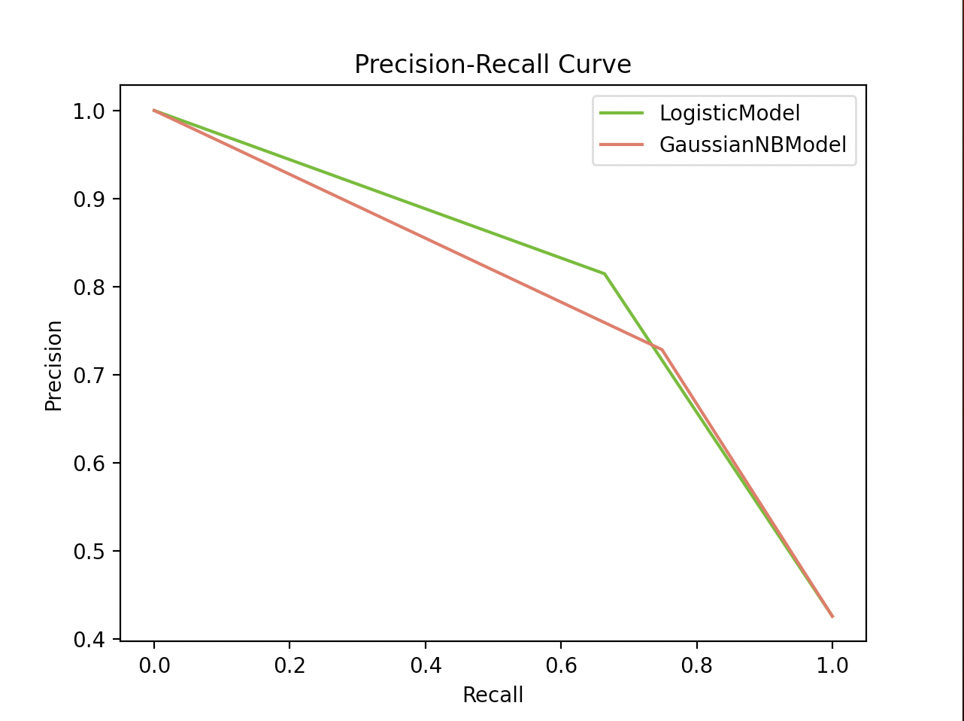
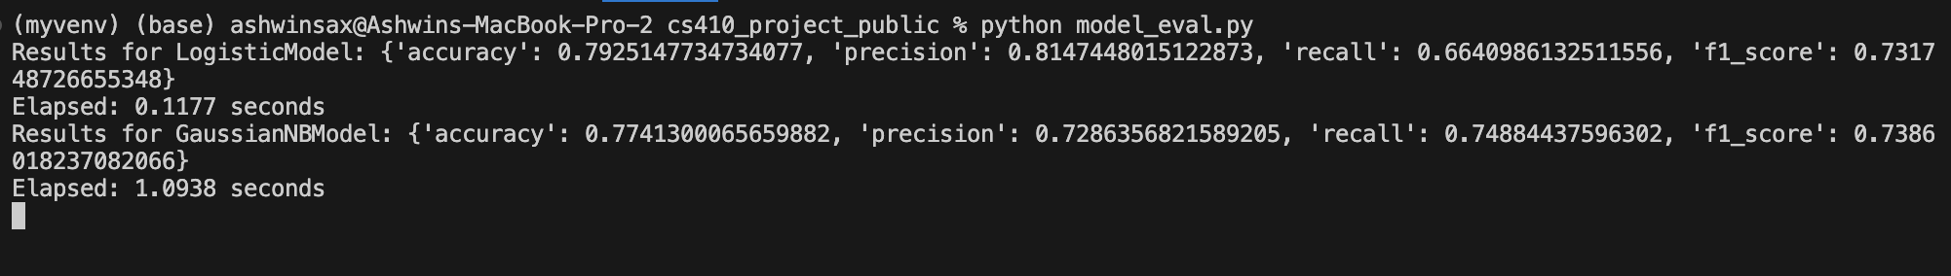
Testing Against Other Models (model_eval.py)
Ensure that your model is listed in the models_to_evaluate list
Call model_eval.py.
See your results!

Slide 14
11 NLP Models Evaluated

Slide 15
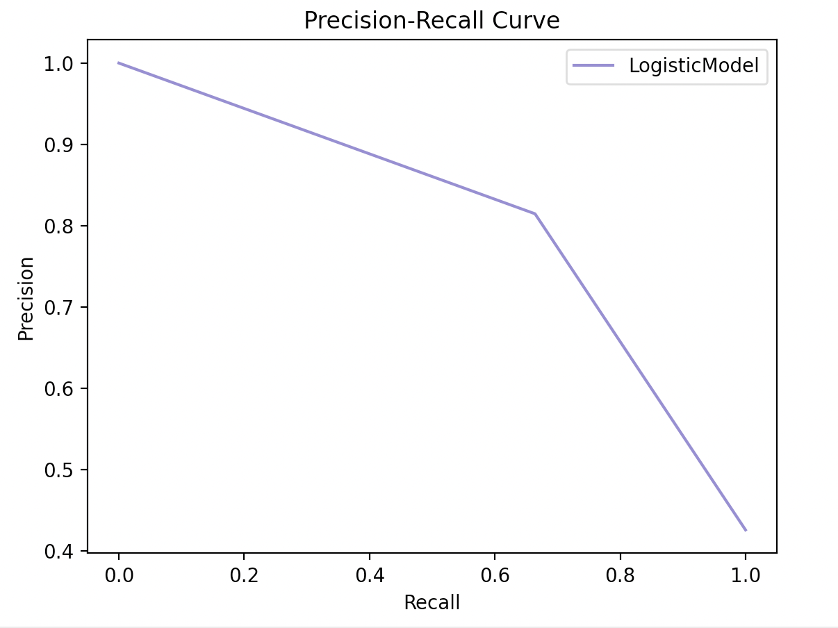
Logistic Model - baseline
This model (also known as logit or MaxEnt) is popular for classification problems and is our baseline for this project
{'accuracy': 0.7925147734734077, 'precision': 0.8147448015122873, 'recall': 0.6640986132511556, 'f1_score': 0.731748726655348}
Elapsed: 0.0932 seconds

Slide 16
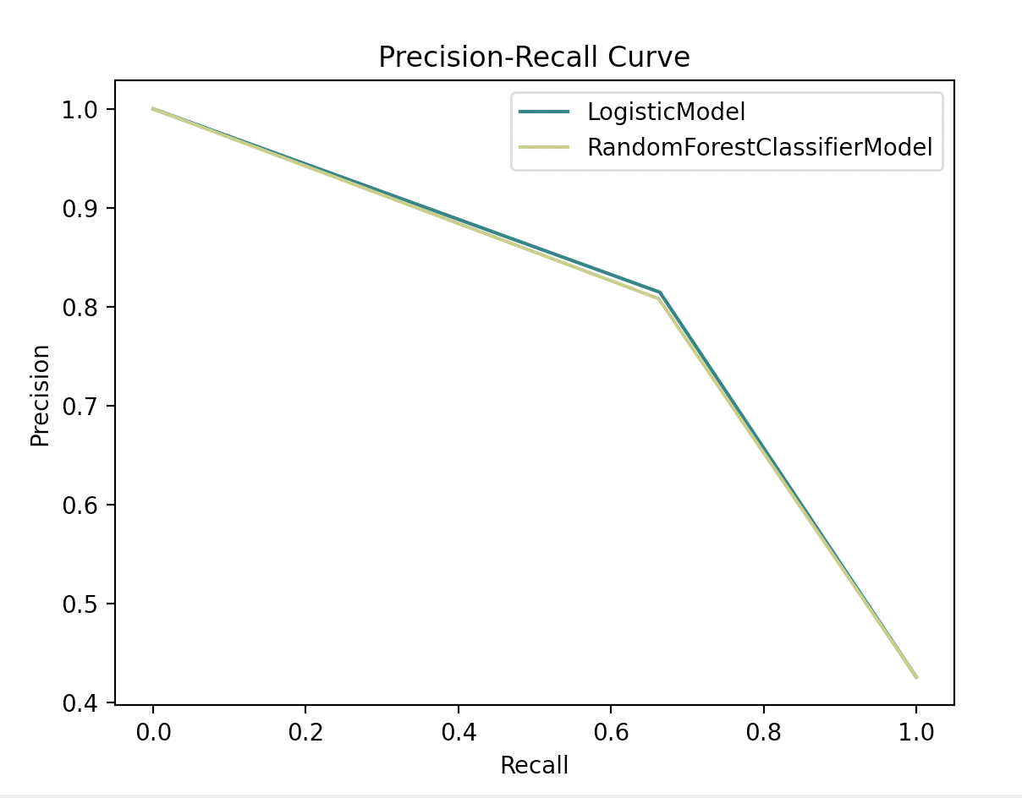
Random Forest Classifier
This model is a meta estimator that fits several decision tree classifiers on various sub-samples of the dataset and uses averaging to improve the predictive accuracy and control over-fitting.
Results for LogisticModel:
{'accuracy': 0.7925147734734077, 'precision': 0.8147448015122873, 'recall': 0.6640986132511556, 'f1_score': 0.731748726655348}
Elapsed: 0.0932 seconds
Results for RandomForestClassifierModel:
{'accuracy': 0.7892317793827971, 'precision': 0.8082706766917294,
'recall': 0.662557781201849,
'f1_score': 0.7281964436917866}
Elapsed: 13.5767 seconds

Slide 17
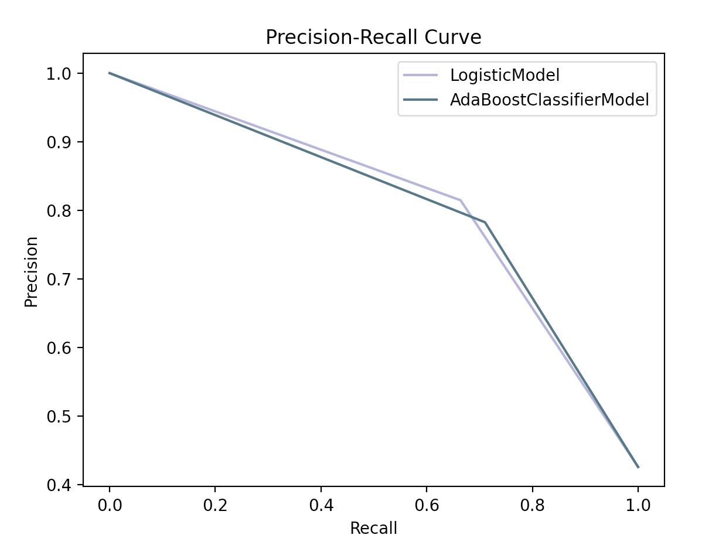
AdaBoost Classifier
This model is a meta-estimator that begins by fitting a classifier on the original dataset and then fits additional copies of the classifier on the same dataset but where the weights of incorrectly classified instances are adjusted such that subsequent classifiers focus more on difficult cases.
Results for LogisticModel:
{'accuracy': 0.7925147734734077, 'precision': 0.8147448015122873, 'recall': 0.6640986132511556, 'f1_score': 0.731748726655348}
Elapsed: 0.0932 seconds
Results for AdaBoostClassifierModel:
{'accuracy': 0.7925147734734077, 'precision': 0.7826825127334465,
'recall': 0.7103235747303543,
'f1_score': 0.7447495961227785}
Elapsed: 780.157 seconds

Slide 18
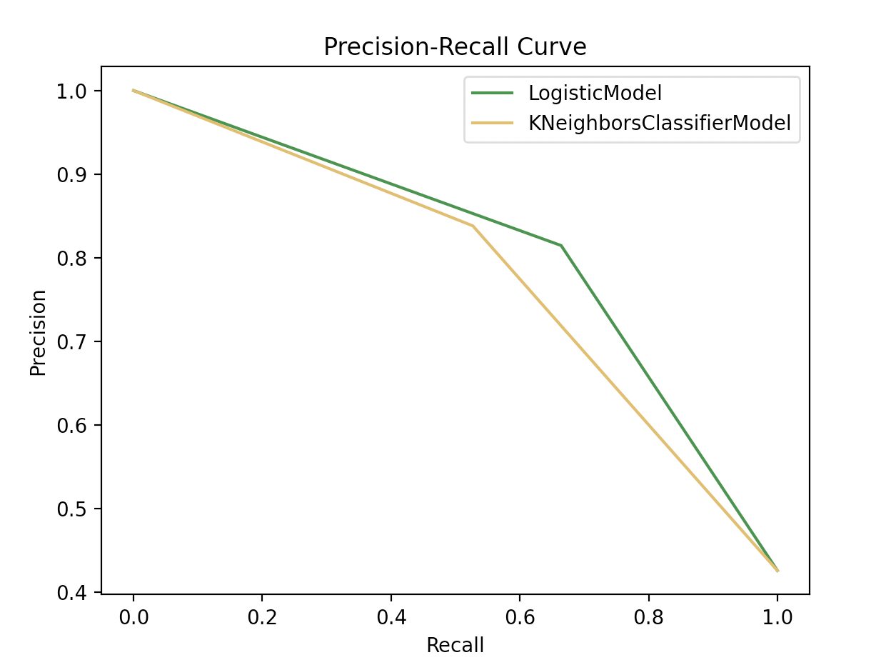
K-Neighbors Classifier
This model implements the k-nearest neighbor's vote.
Results for LogisticModel:
{'accuracy': 0.7925147734734077, 'precision': 0.8147448015122873, 'recall': 0.6640986132511556, 'f1_score': 0.731748726655348}
Elapsed: 0.0932 seconds
Results for KNeighborsClassifierModel:
{'accuracy': 0.7550886408404465, 'precision': 0.8382352941176471,
'recall': 0.5269645608628659,
'f1_score': 0.6471144749290444}
Elapsed: 0.3079 seconds

Slide 19
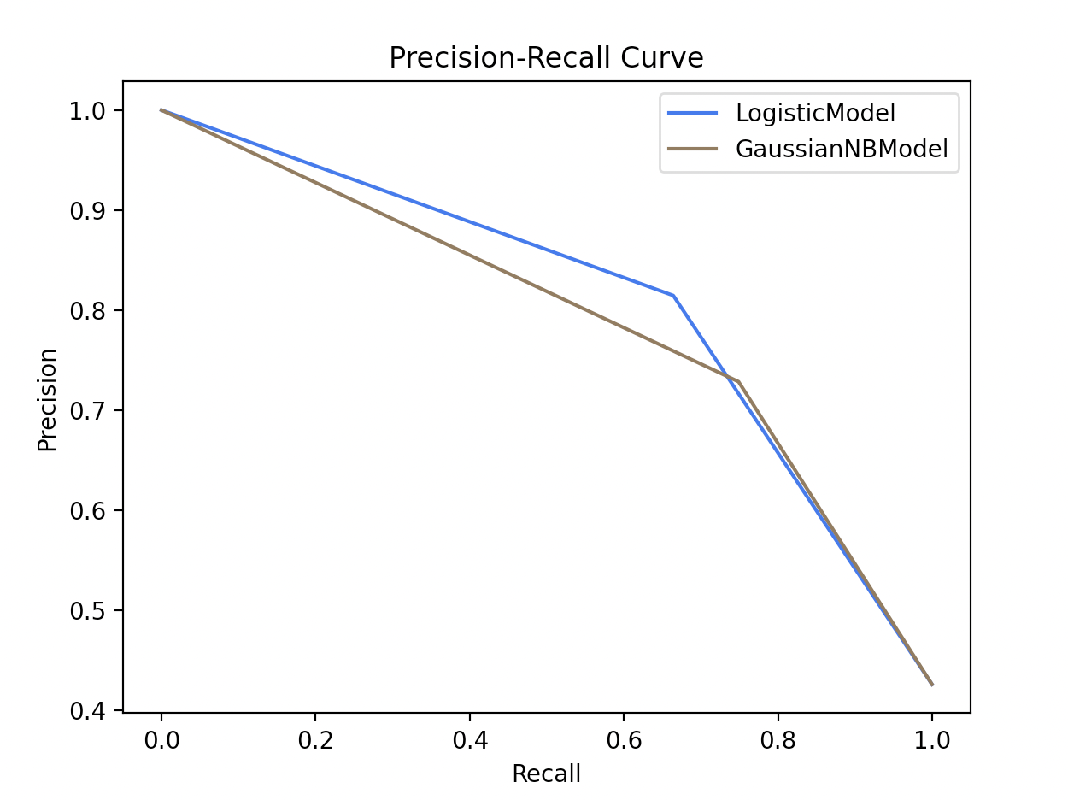
Naïve Bayes
This model has a set of supervised learning algorithms based on applying Bayes’ theorem with the “naive” assumption of conditional independence between every pair of features given the value of the class variable
Results for LogisticModel:
{'accuracy': 0.7925147734734077, 'precision': 0.8147448015122873, 'recall': 0.6640986132511556, 'f1_score': 0.731748726655348}
Elapsed: 0.0932 seconds
Results for GaussianNBModel:
{'accuracy': 0.7741300065659882, 'precision': 0.7286356821589205,
'recall': 0.74884437596302,
'f1_score': 0.7386018237082066}
Elapsed: 0.4472 seconds

Slide 20
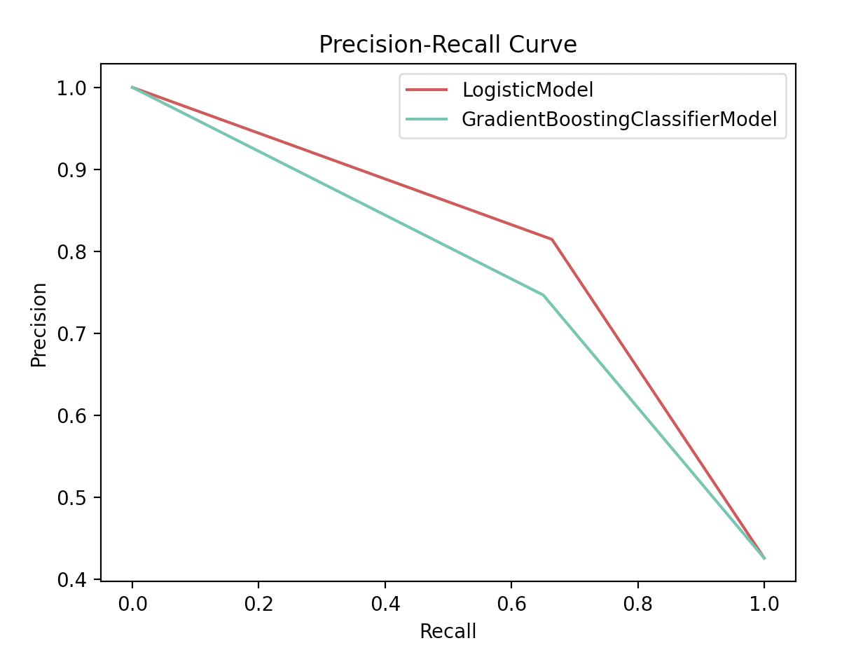
Gradient Boosting Classifier
This model builds an additive model in a forward stage-wise fashion; it allows for the optimization of arbitrary differentiable loss functions.
Results for LogisticModel:
{'accuracy': 0.7925147734734077, 'precision': 0.8147448015122873, 'recall': 0.6640986132511556, 'f1_score': 0.731748726655348}
Elapsed: 0.0932 seconds
Results for GradientBoostingClassifierModel:
{'accuracy': 0.7570584372948129, 'precision': 0.7469026548672566,
'recall': 0.650231124807396,
'f1_score': 0.6952224052718287}
Elapsed: 1.014 seconds

Slide 21
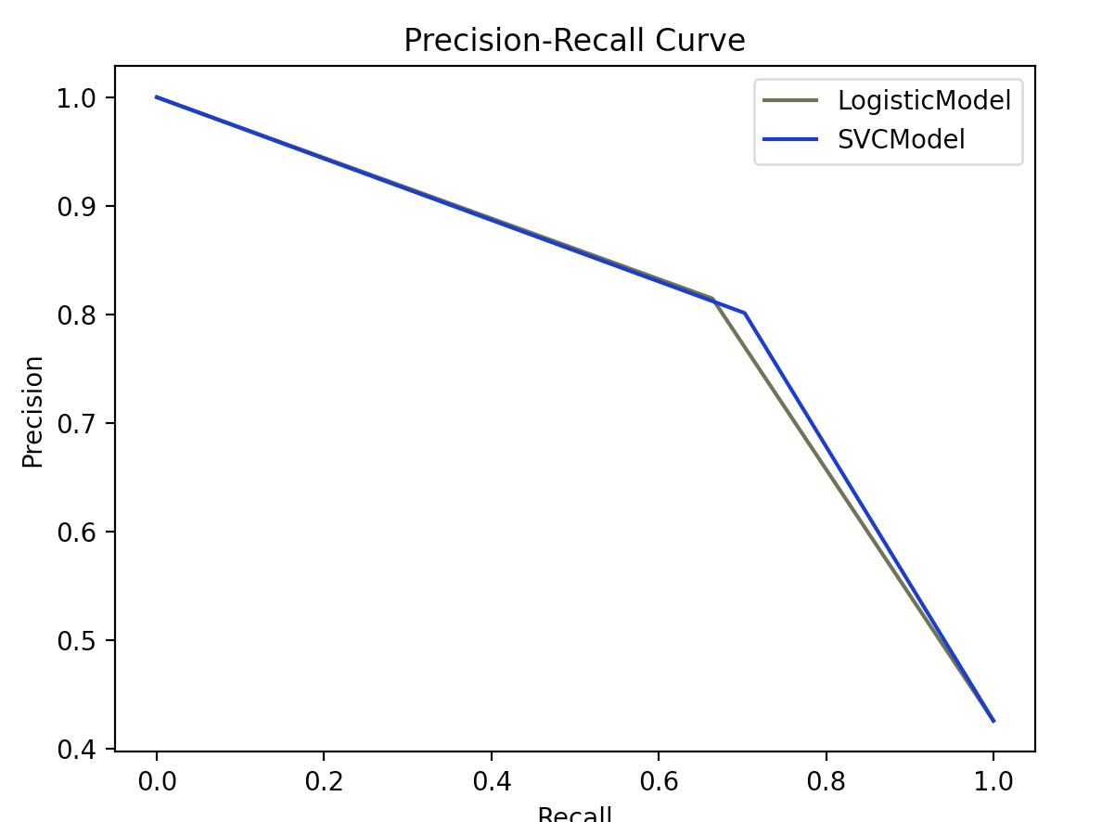
Support Vector Classifier (SVC)
This model is a linear support vector classification model.
Results for LogisticModel:
{'accuracy': 0.7925147734734077, 'precision': 0.8147448015122873, 'recall': 0.6640986132511556, 'f1_score': 0.731748726655348}
Elapsed: 0.0932 seconds
Results for SVCModel:
{'accuracy': 0.799080761654629, 'precision': 0.8014059753954306,
'recall': 0.7026194144838213,
'f1_score': 0.7487684729064038}
Elapsed: 0.1691 seconds

Slide 22
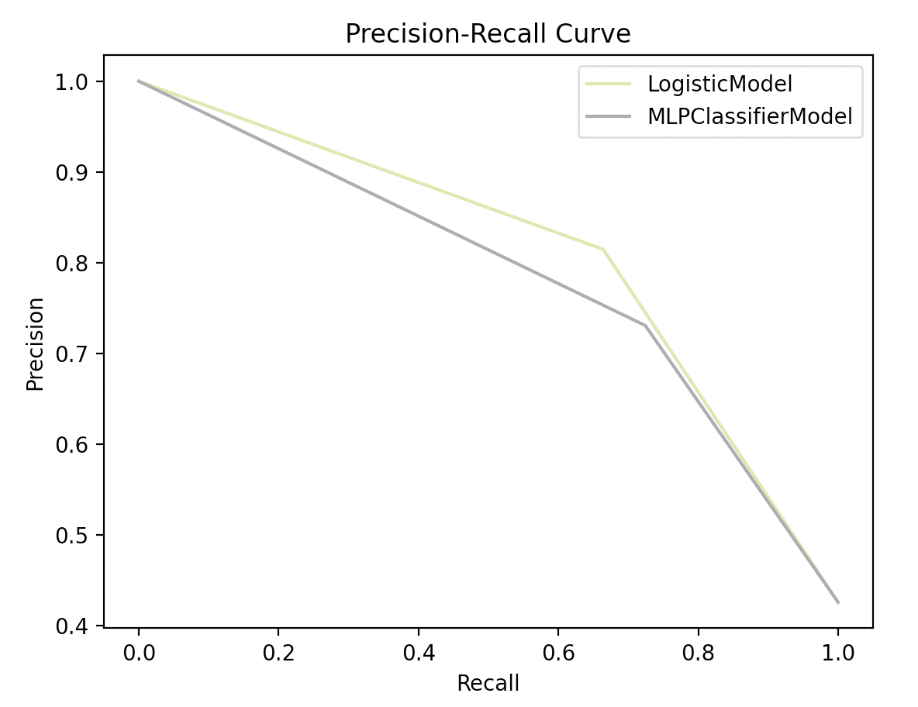
Multi-layer Perceptron (MLP) Classifier
This model optimizes the log-loss function using LBFGS or stochastic gradient descent.
Results for LogisticModel:
{'accuracy': 0.7925147734734077, 'precision': 0.8147448015122873, 'recall': 0.6640986132511556, 'f1_score': 0.731748726655348}
Elapsed: 0.0932 seconds
Results for MLPClassifierModel:
{'accuracy': 0.7688772160210111, 'precision': 0.7309486780715396,
'recall': 0.724191063174114,
'f1_score': 0.7275541795665633}

Slide 23
Decision Tree Classifier
This model predicts the value of a target variable by learning simple decision rules inferred from the data features. A tree can be seen as a piecewise constant approximation.
Key Learnings:
What hyperparameters worked well? Why?
Where the model did well?
Where the model did not?
Precision Recall Plot
Results for DecisionTreeClassifierModel: {'accuracy': 0.6710439921208142, 'precision': 0.6428571428571429, 'recall': 0.5130970724191063, 'f1_score': 0.570694087403599}
Elapsed: 0.5596 seconds

Slide 24
K-Means
This model clusters data by trying to separate samples in n groups of equal variance, minimizing a criterion known as the inertia or within-cluster sum-of-squares.
Key Learnings:
What hyperparameters worked well? Why?
Where the model did well?
Where the model did not?
Precision Recall Plot

Slide 25
Latent Dirichlet Allocation (LDA)
This model is a generative probabilistic model for collections of discrete dataset such as text corpora. It is also a topic model that is used for discovering abstract topics from a collection of documents.
Key Learnings:
What hyperparameters worked well? Why?
Where the model did well?
Where the model did not?
Precision Recall Plot
Classification Report
 | Precision | Recall | F1-score | Support
Accuracy
Macro avg.
Weighted avg.

Slide 26
Source Code

Slide 27
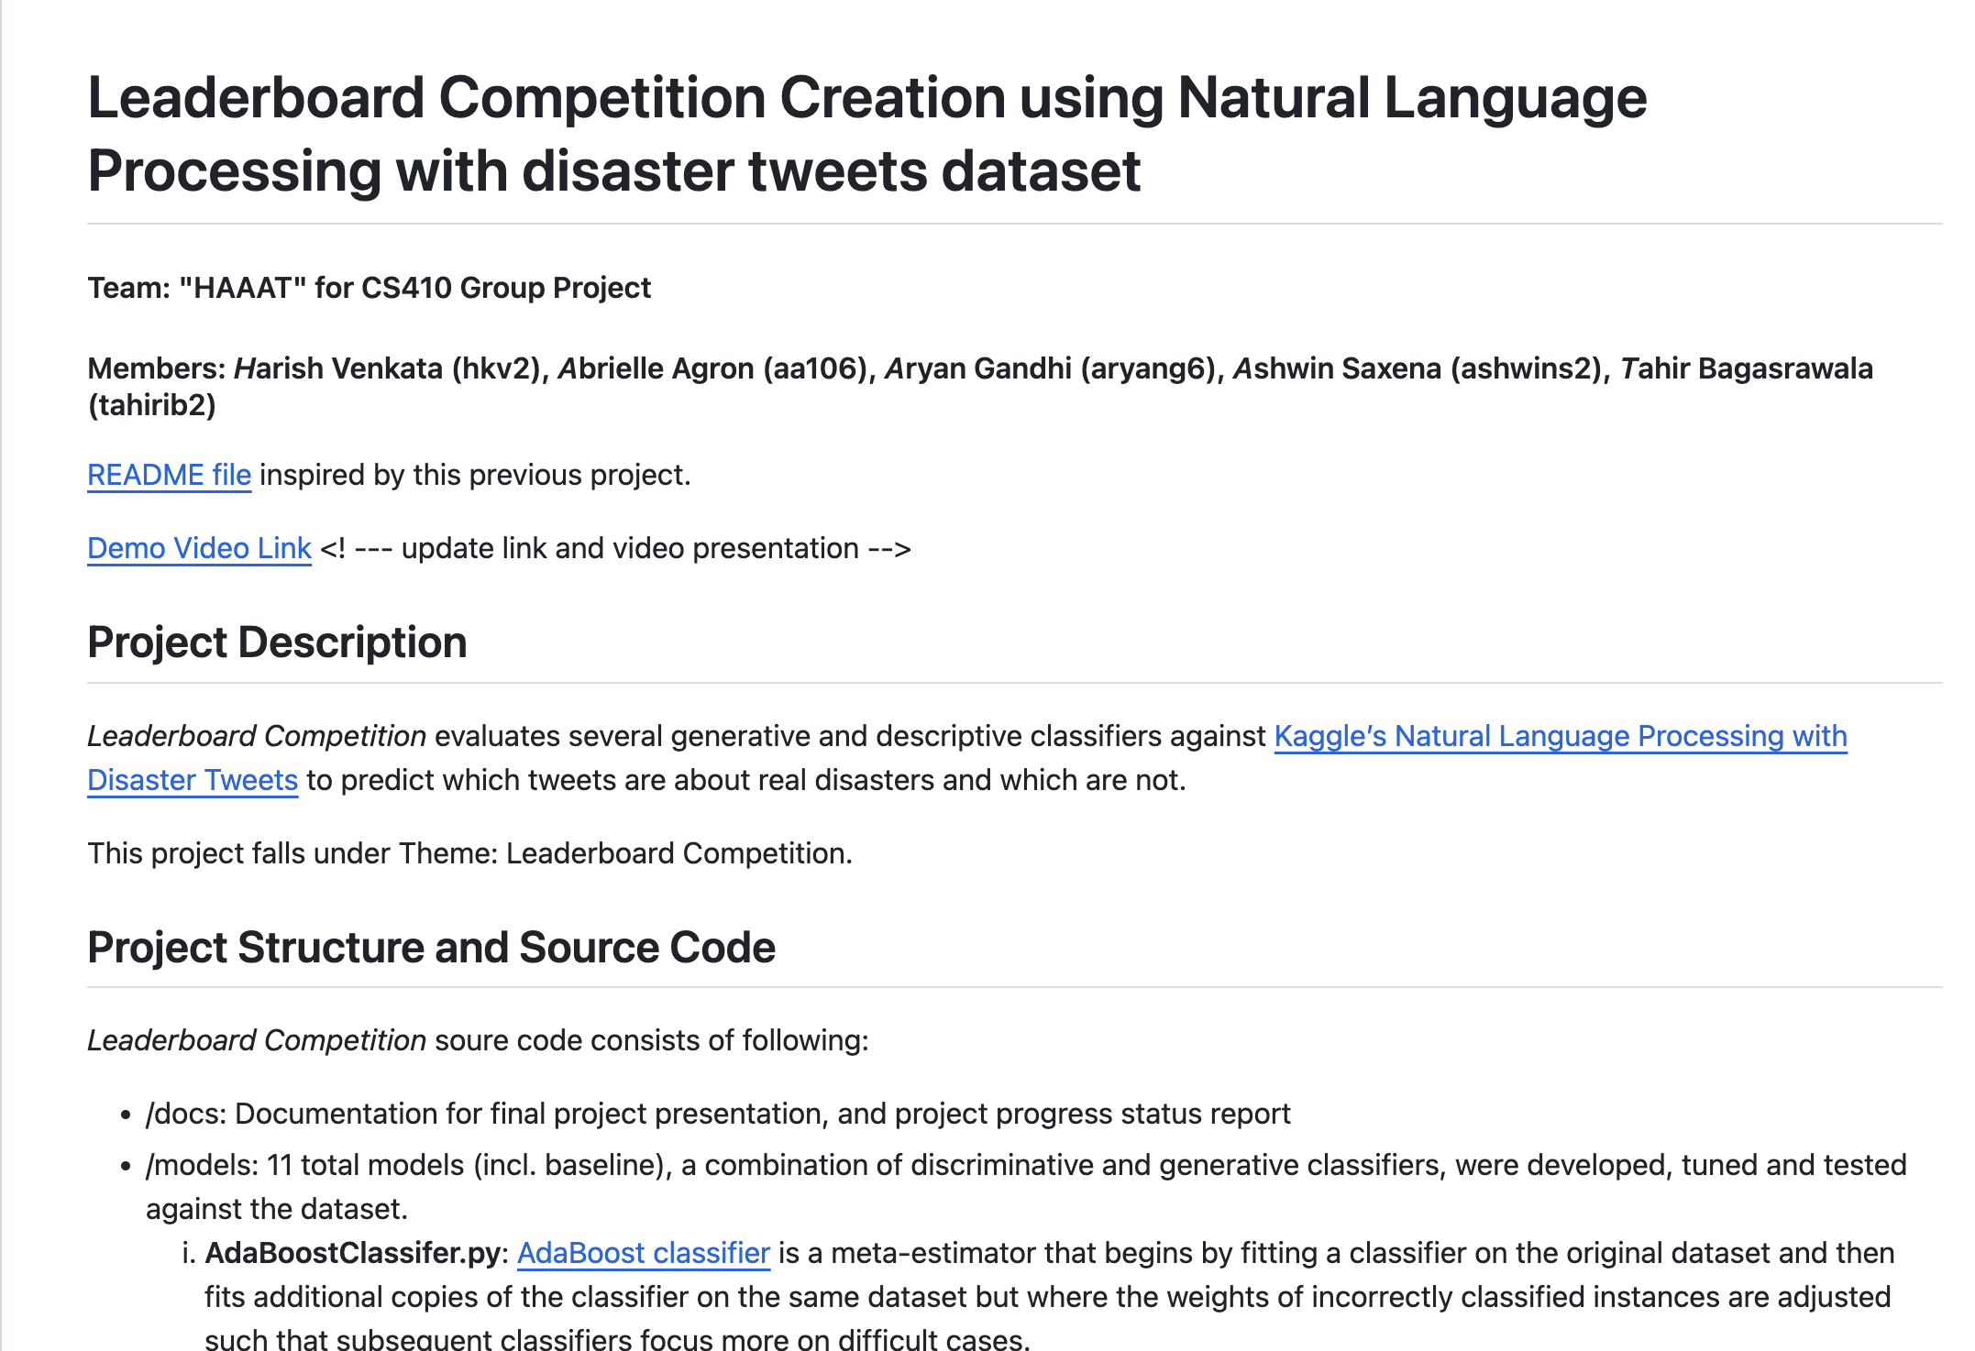
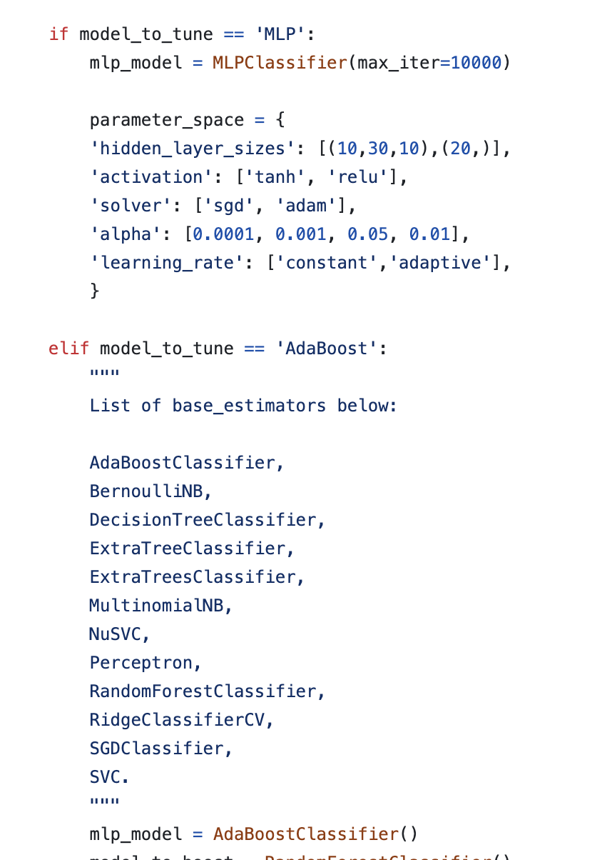
Source Code
https://github.com/tahirbags/cs410_project_public/tree/main

Slide 28
Video Presentation

Slide 29
Video Presentation
LINK OF VIDEO
IMAGE OF VIDEO

